Slide 1
Project 4:Online Shopping Kart
Safe. Secure. Errorfree

Slide 2
Project Members
Harshal Patil (Group Leader)
Kunal Jangle
Atul More
Aniket Patil
Nikhita Badjate
Shraddha Ranade

Slide 3
Contents

Slide 4
Objective
The E-commerce Shopping System is a web-based application. The purpose of
the application is to automate and facilitate the whole process of shopping. This
application fixes the limition and problems of paper based processes. The main
goal to increase the quantity of sales by making the new technology of web
pages design more attractive and to search a lot of customers and company to
their location. By this system we can advertise and send procure to a lot of
customer by sending email.

Slide 5
Introduction:
Every organization, weather big or small, has challenges to
overcome and managing the information of customers, product, order,
Type, payment, every Ecommerce Shopping System has different product
needs, therefore we design exclusive product management systems that are
adapted to your managerial requirements. This is designed to assist in
strategic planning, and will help you ensure that your organization is
equipped with the right level of information and details for your goals

Slide 6
Admin Module
Admin has to verify customer details such as email address, contact number, name.
Admin has to categorize various products according to description.
Admin has to manage product info, description, discount, price, and product image.
Admin has to manage and process order.

Slide 7
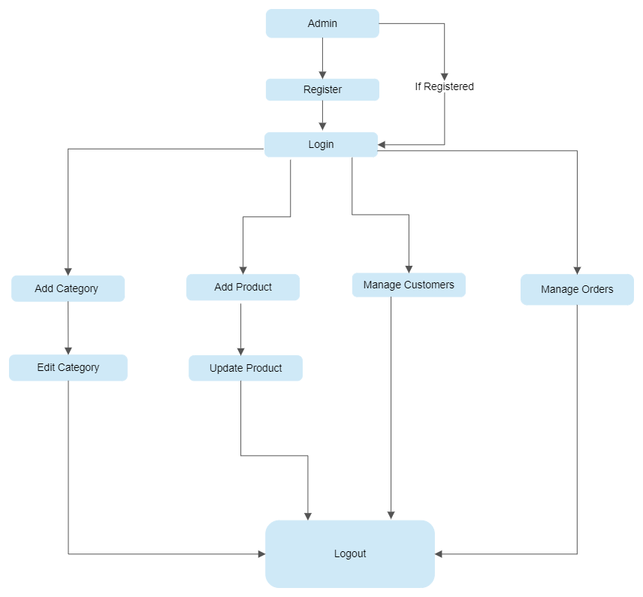

Slide 8
Customer Module
Customers can search products and liked one can be added to cart.
Once Payment is successful order is confirmed.
Various information like name, password, address, can be changed through settings.
Customers can access payment report.
Customers can track the order.

Slide 9
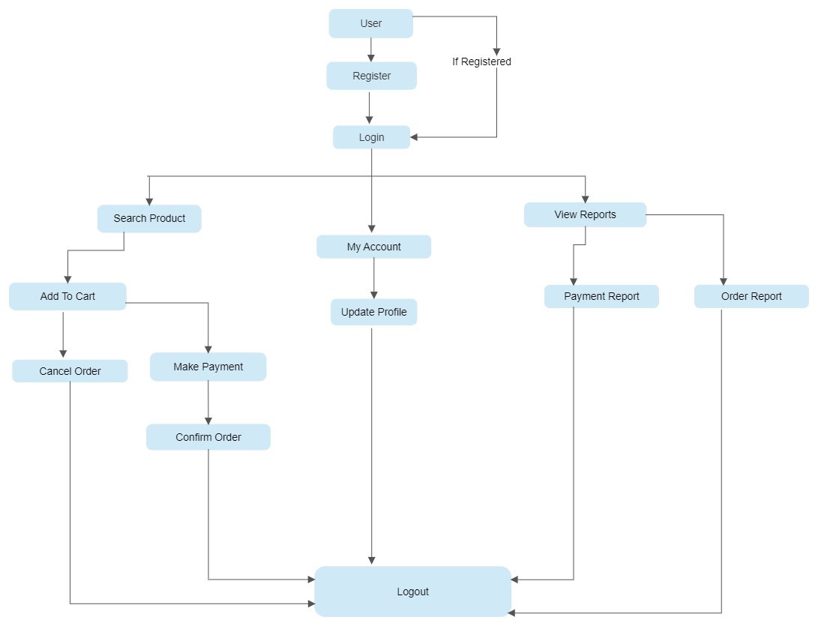

Slide 10
Customer Order Process
Users can shortlist the shopping and add it in wishlist. Then they can add the items in the shopping basket. They can adjust the quantity here.
Payment if not successful leads to failure in order placement.
If Payment is done the order can be tracked on various stages like order placed, order packed, order dispatched, Order Shipped.
Once order is received the process is complete.

Slide 11
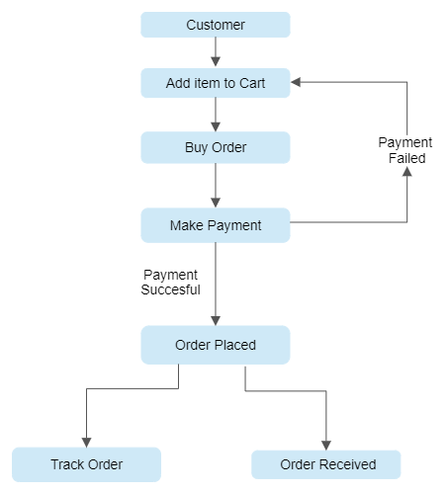

Slide 12
Connectivity between admin and user
Connection is explained in the following tree diagram.

Slide 13
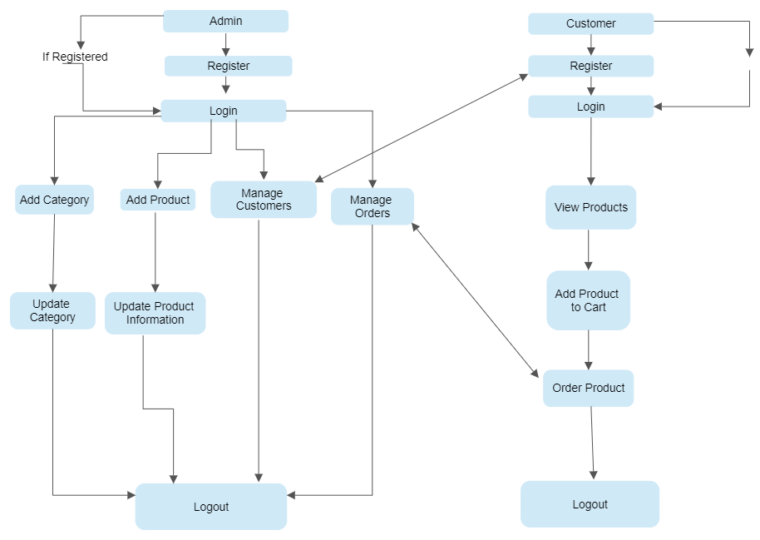

Slide 14
thankyou!!

